Slide 1

TITLE

Slide 2
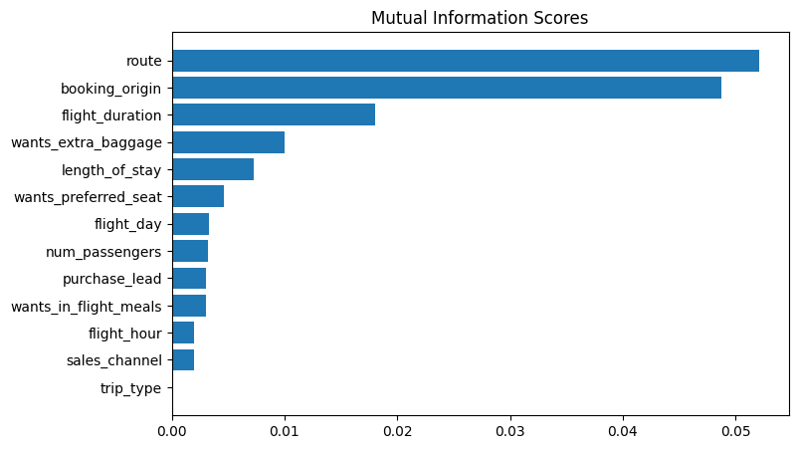
PREDICITVE MODEL TO UNDERSTAND FACTORS THAT INFLUENCE BUYING BEHAVIOR
We have trained the data with two classifier model;Random Forest and XGBoost and received
ACCURACY: 84.96000000000001
AUC score: 0.5431644571912829
route
booking_origin
flight_duration
wants_extra_baggage
length_of_stay
are the top 5 features which influence Customer buying behaviour

